Slide 1


Markit Technovation 2016
The Science of Finance
GAURAV AGARWAL
NITIN SINGH
PARAG GARG

Slide 2

IDEA DESCRIPTION
Markit is a data oriented company and almost all products revolve around parsing of raw data, enriching and finally distributing.
Problem
At present all teams try to achieve the same business goal, using different technologies in different ways.
Solution
Our goal is to provide the common open source platform for parsing & loading feed files like XML, which can be used across Markit.

Slide 3

PROBLEM --- MANUAL INTERVENTION
Creation of new JAVA (Maven) project
Generation of POJO (JAXB) classes
Creating Database (SQL) scripts
Creating new Database Model
Tables, Sequence, Primary Key, Foreign Key.
At present, no tool exist to map Parent – Child relationship of XSD into Relational database tables.
Creating new Parser classes for reading XML based on XSD
  XML Validation
  XML Un-marshalling
Generating new Loader framework for CRUD operations

Slide 4

SOLUTION -- FULL AUTOMATION
Creation of new Java (Maven) project on the fly
  With default configuration & Customizable
Creation of POJO (JAXB) classes on the fly from given XSD
  Further used for Marshaling/Un-marshalling
Generation of SQL scripts from XSD
  Converting Parent – Child relationship into Relational database scripts
Login to Database for Table, Sequence , Constraints creation
  Automatically mapping 1-to-1 and 1-to-Many relationship
  Options to create scripts based on different database like Oracle, MS SQL
Generate Parser for reading and writing XMLs
Generate generic Loader Framework within new Java project
  Multi threaded Framework
  Reading data from database
  Writing data into database

Slide 5
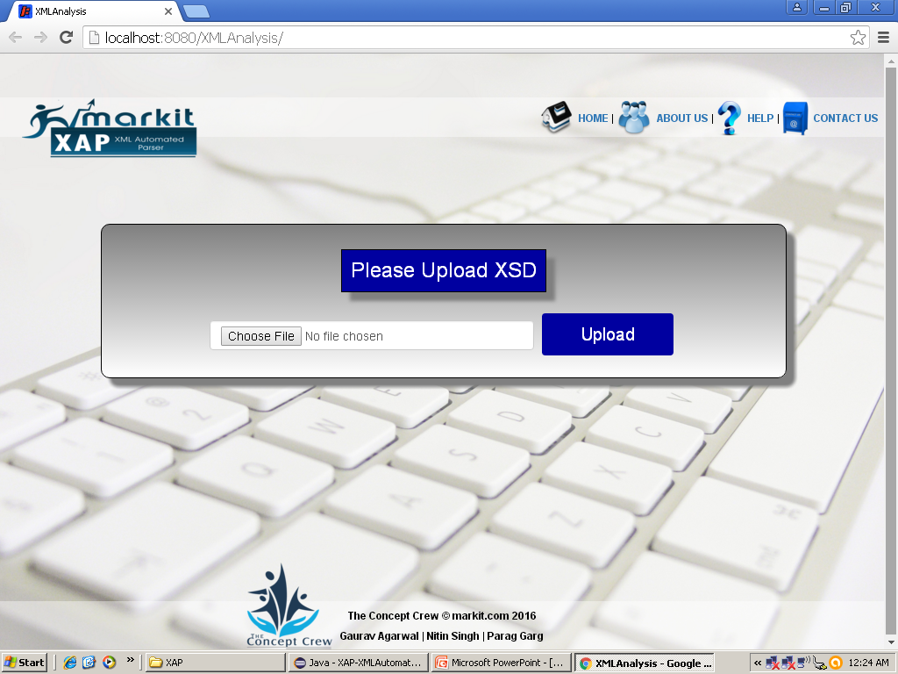

Proof of Concept – Screenshot (Home Page)

Slide 6

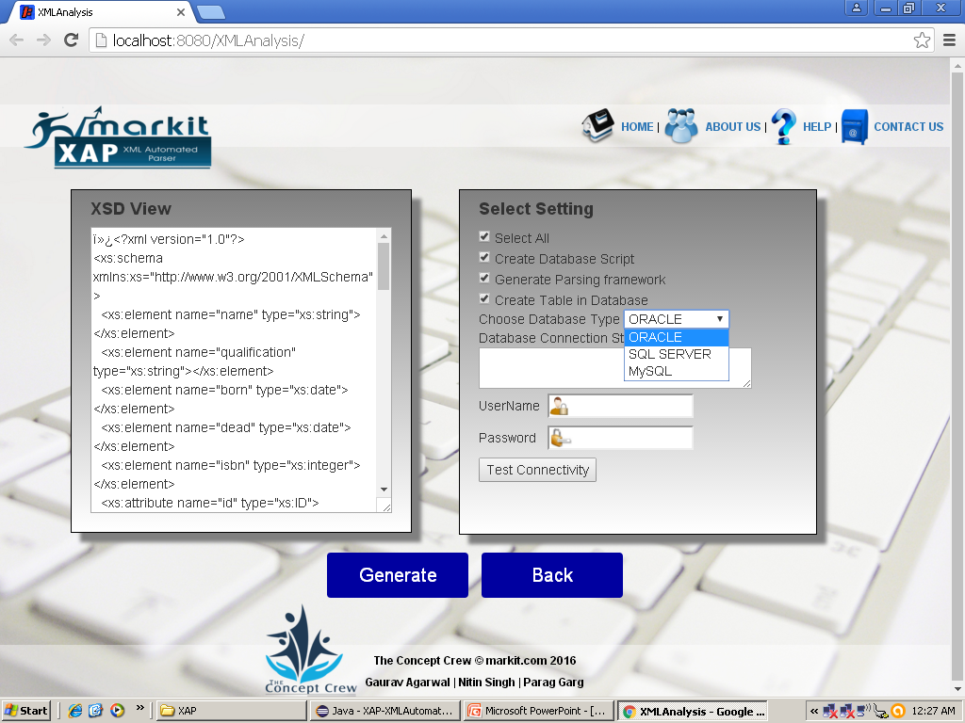
Proof of Concept – Screenshot (Second Page)

Slide 7

GAURAV AGARWAL
NITIN SINGH
PARAG GARG

